Slide 1
AEROFIX STRUCTURAL SERVICES

Slide 2
ABOUT US
OWNED AND OPERATED BY RUBEN CORREA
CONSULTANT FAA-DER ON STAFF
MODIFICATIONS AND REPAIRS ON ANY AIRCRAFT STRUCTURES
ADDITIONAL MANDATORY TWIN COMMANDER APPROVED TRAINING
OVER 18 YEARS EXPERIENCE

Slide 3
MOBILE, DEPENDING ON THE TASK TO BE PERFORMED
HIGH QUALITY SHEETMETAL SERVICES WITH REMARK TO DETAILS
AIMING FOR EXCEPTIONAL CRAFTSMANSHIP
BUILDING STRONG REPUTATION
STAND BEHIND OUR WORK
HOPE YOU WILL SPREAD THE WORD

Slide 4
SERVICES
MAJOR STRUCTURAL REBUILDING
MINOR MODIFICATIONS
REPAIRS AND REPLACEMENTS SUCH AS:
DOUBLERS, STINGERS, LONGERONS, BULKHEADS
WING SPARS, BEAMS, RIBS, FUSELAGE

Slide 5
CORROSION INSPECTION, REMOVAL AND REPAIR
SERVICE BULLETINS & AIRWORTHINESS DIRECTIVES
STC INSTALLATIONS
TWIN TURBO & JET PROP COMMANDERS
CESSNA, BEECHCRAFT, AIRBUS, BOEING AMONG MANY OTHERS

Slide 6
Portfolio – Summary
SB208A / CK144
SB223 (AD 98-08-19)
SB235
SB241
(AD 2013-09-05)
SB236A + SB 238 (AD 2006-15-01)
SB237
SB239
Contact Info

Slide 7
Service Bulletin 208A / Custom Kit 144
Inspection for Wing Lower Spar Cap Corrosion / Lower Spar Cap Replacement

Slide 8
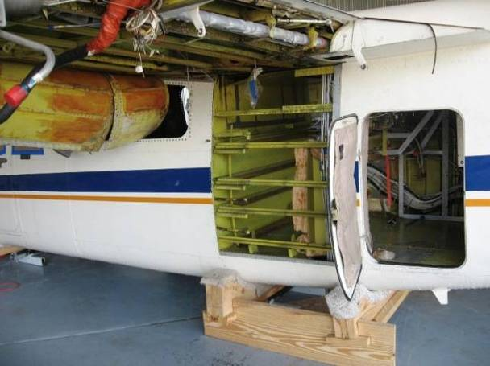
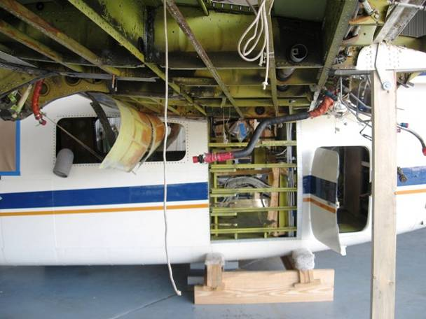

Slide 9
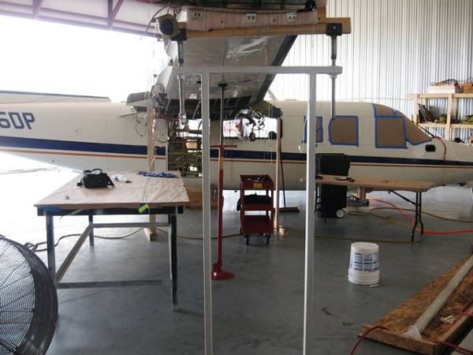
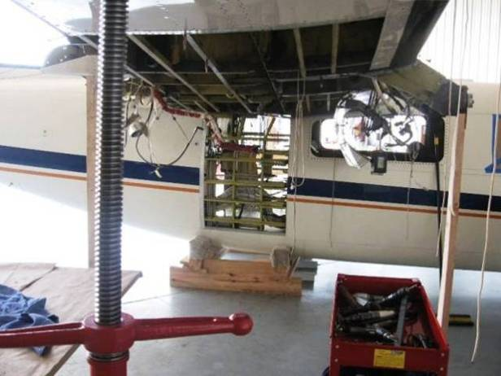
General view of dismantling of airplane

Slide 10
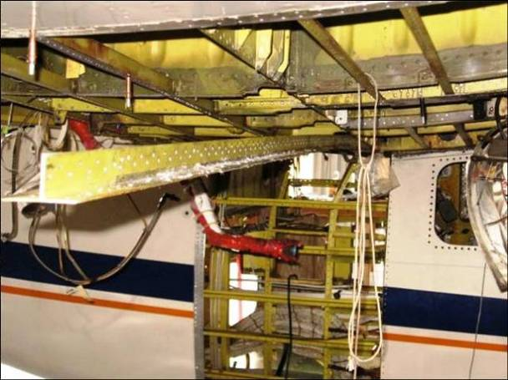
Old lower spar cap being removed – View A

Slide 11
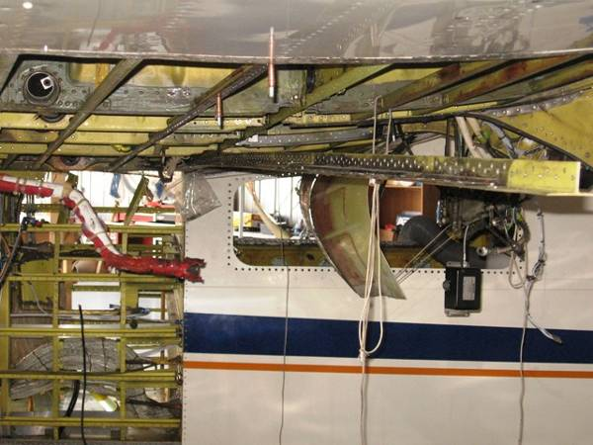
Old lower spar cap being removed – View B

Slide 12
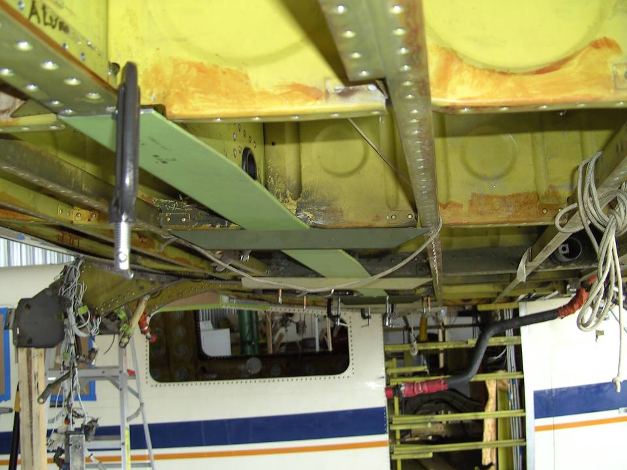
New lower spar cap being installed

Slide 13
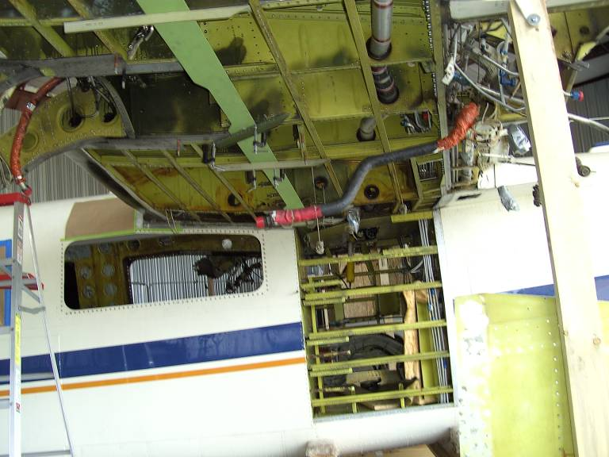
New lower spar cap being installed

Slide 14
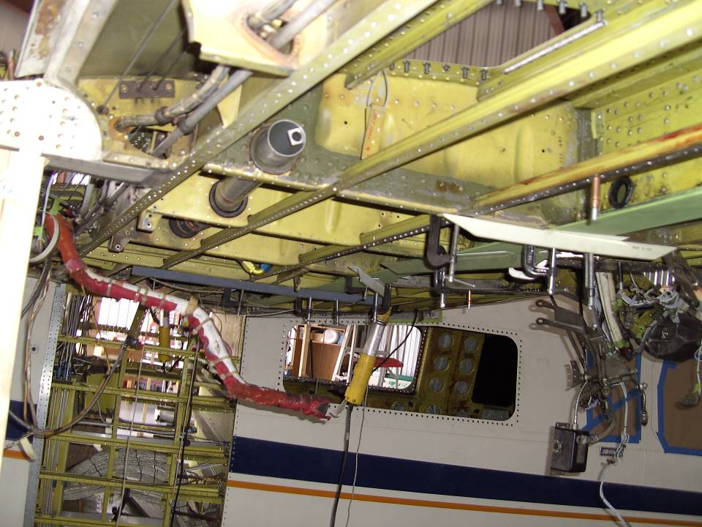
New lower spar cap being installed

Slide 15
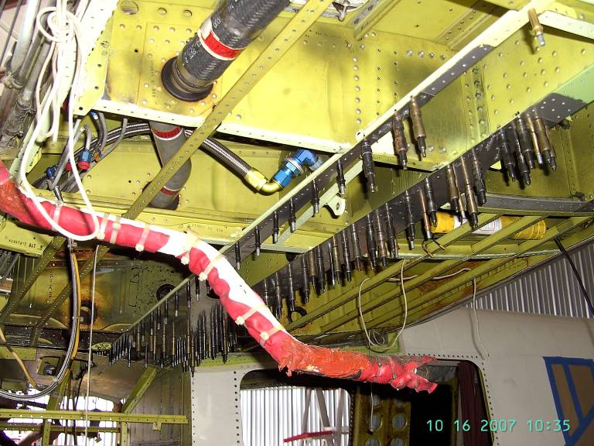
New lower spar cap being installed

Slide 16
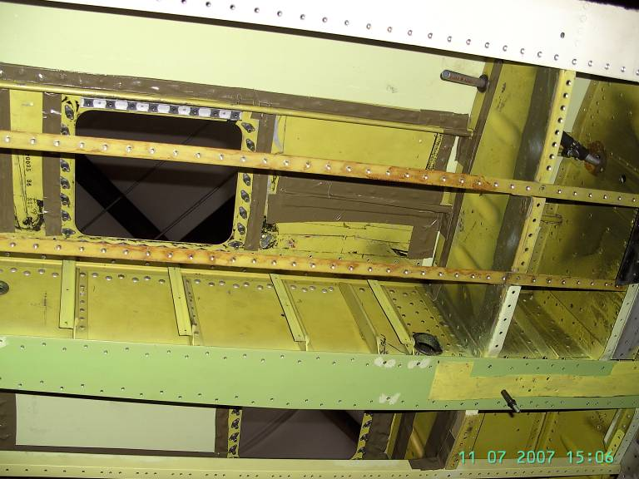
Lower spar cap being installed

Slide 17
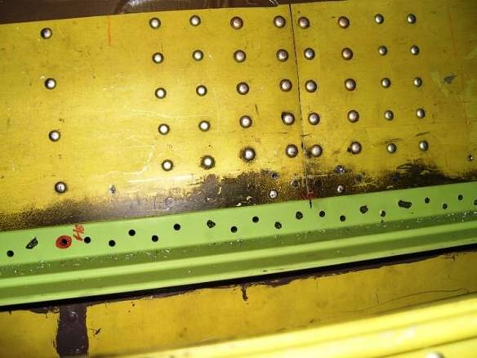
Center Tank Section – View A
New lower spar cap being installed – Vertical leg drilled

Slide 18
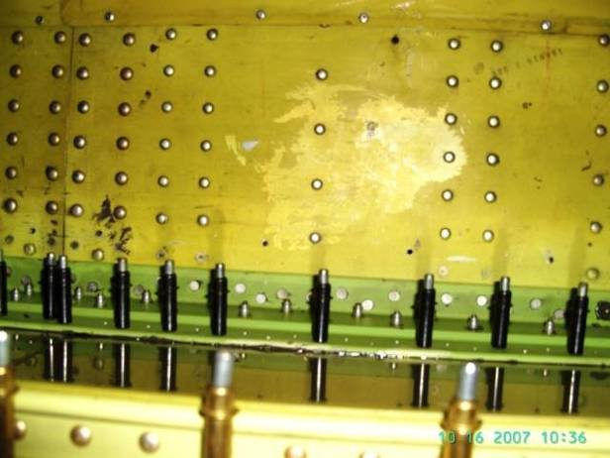
Center Tank Section – View B
New lower spar cap being installed – Vertical leg installed – Horizontal leg partially installed

Slide 19
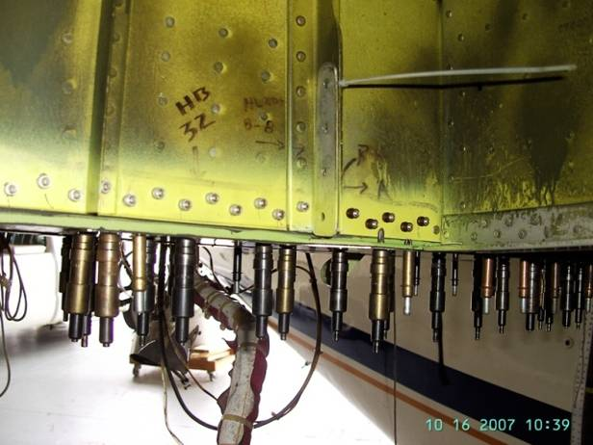
Vertical leg of new lower spar cap installed on wing section – View A

Slide 20
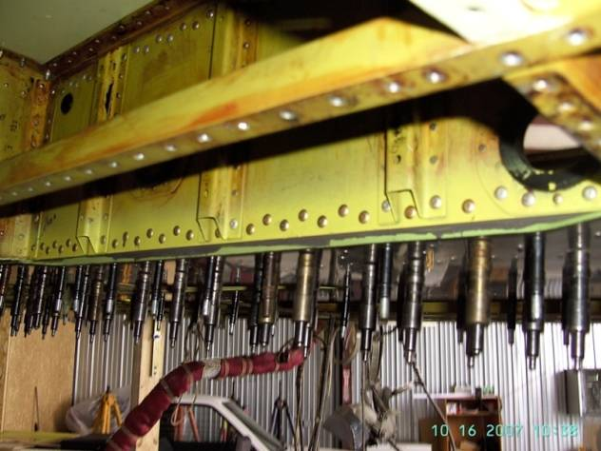
Vertical leg of new lower spar cap installed on wing section – View B

Slide 21
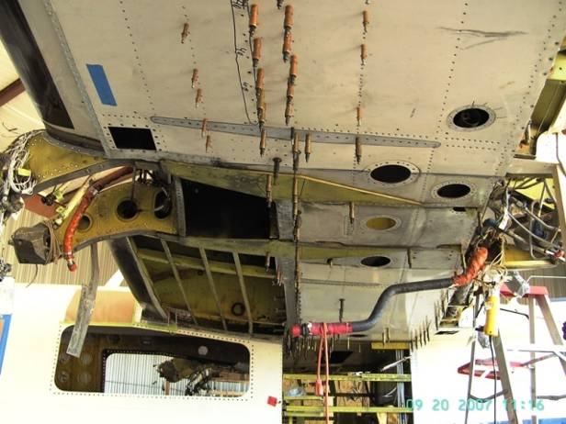
Horizontal leg of lower spar cap being drilled

Slide 22
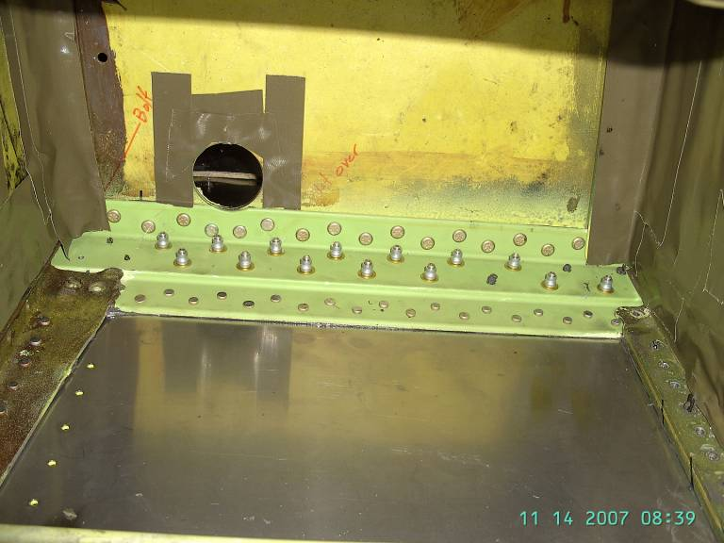
New lower spar cap being installed – View inside A

Slide 23
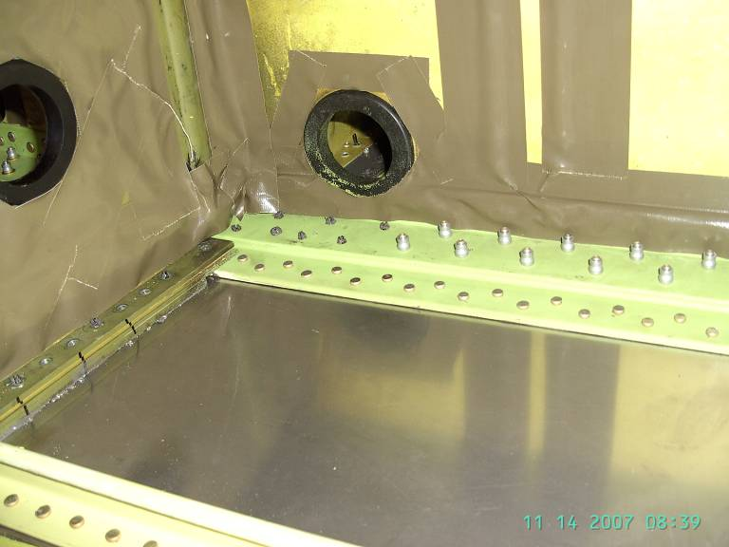
New lower spar cap being installed – View inside B

Slide 24
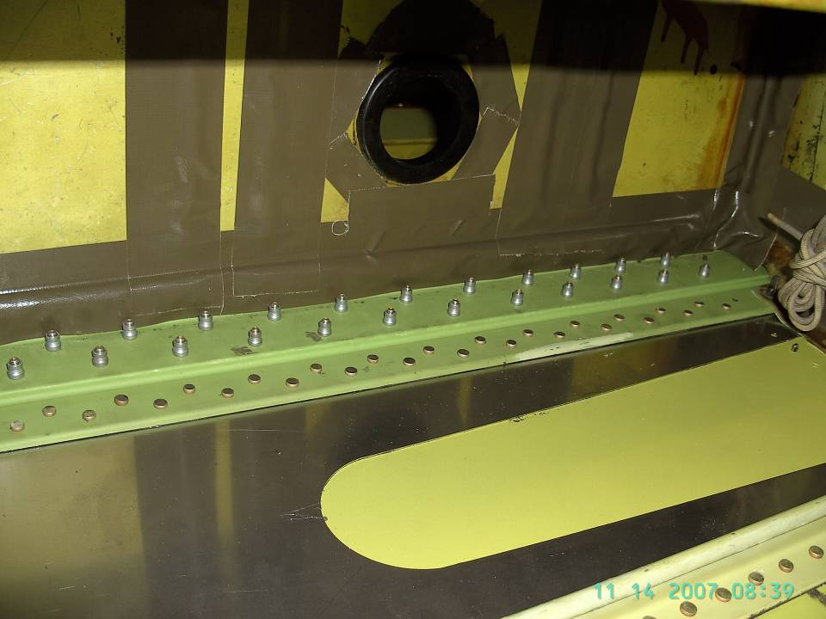
New lower spar cap being installed – View C

Slide 25
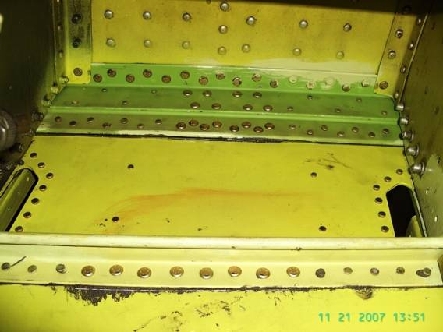
Landing gear section – Top view
New lower spar cap installed
New stringer installed

Slide 26
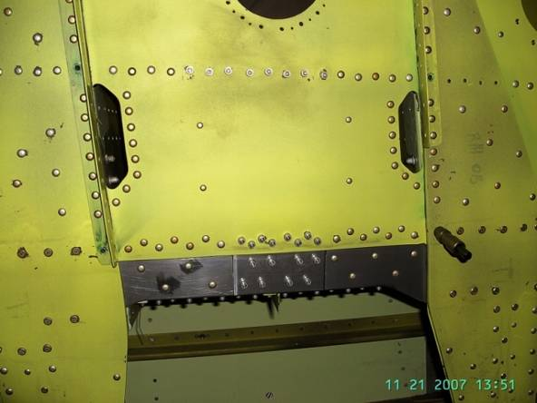
Landing gear section – Bottom View
Stringer
Lower Spar Cap

Slide 27
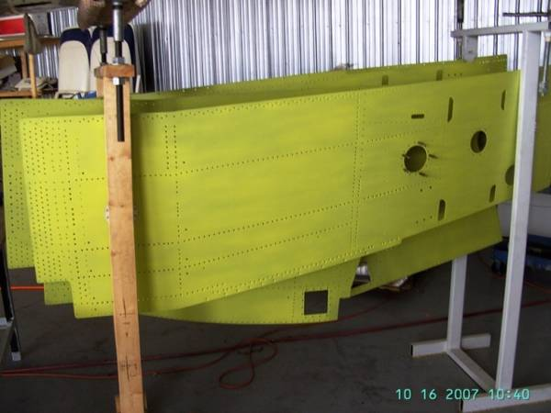
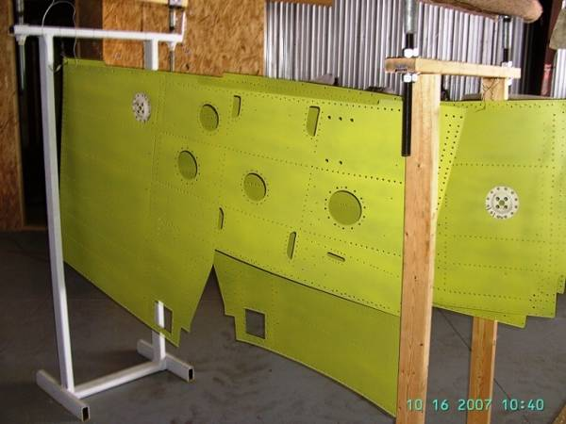
New lower skins manufactured due to found corrosion

Slide 28
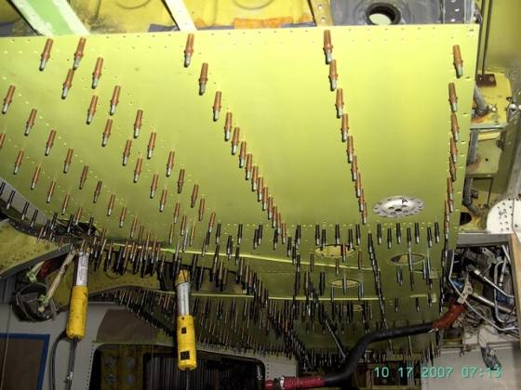
New manufactured skins being installed

Slide 29
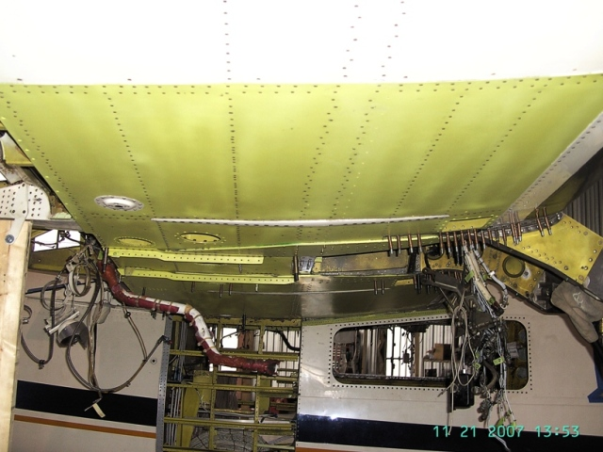
New Lower Skins Installed
Inboard and Outboard Plates installed
Inboard and Outboard Straps installed

Slide 30
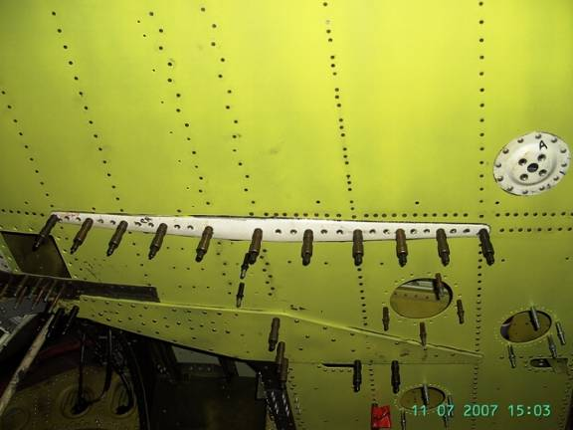
Plate being installed

Slide 31
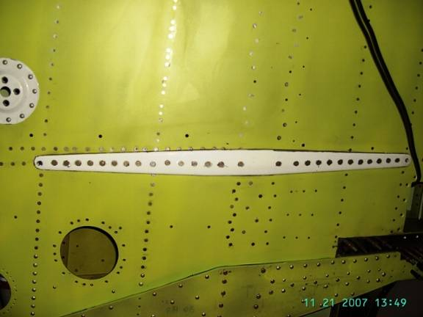
Plate installed

Slide 32
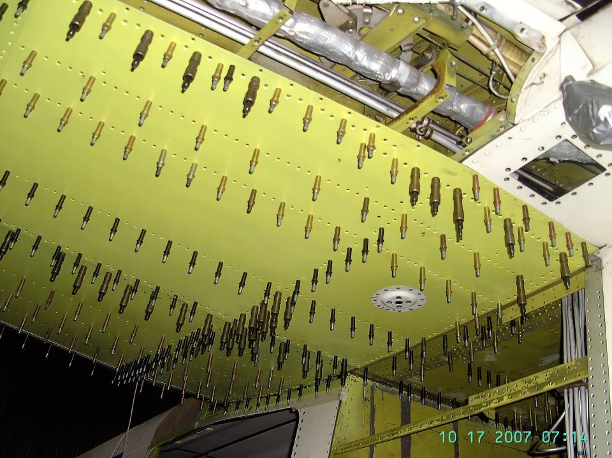

Slide 33
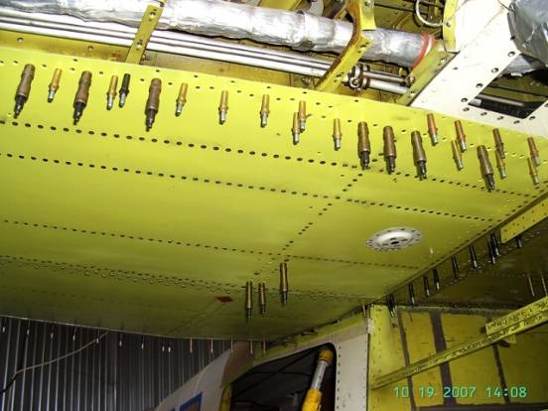
Aft spar fastener’s line
Wing root fairing not installed
Side skin not installed

Slide 34
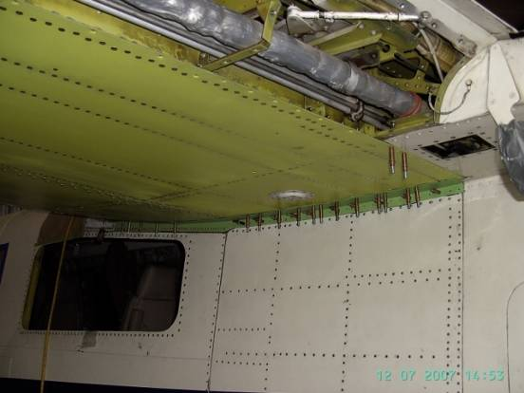
Aft Spar fasteners installed
Wing root fairing being installed
Side skin installed

Slide 35
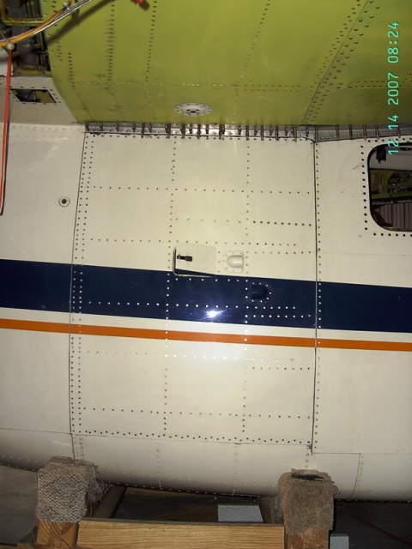
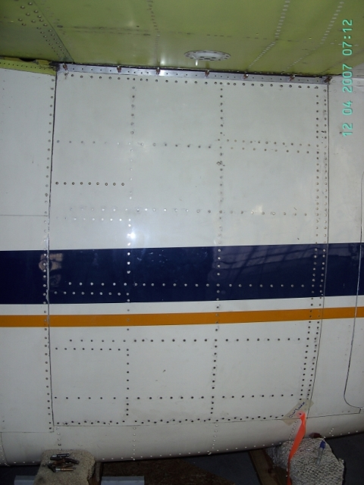
Left and right side skins installed
Return to summary
Contact info

Slide 36
Service Bulletin 223 (AD 98-08-19)
Wing Leading Edge Attachment Inspection and Modification

Slide 37
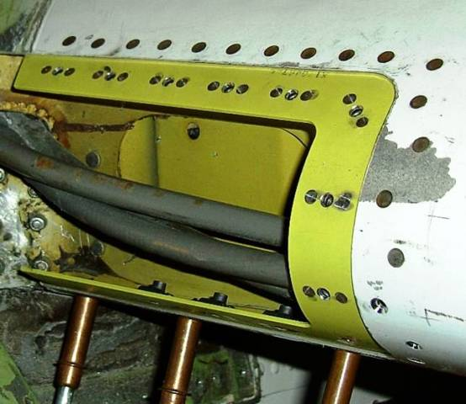

Slide 38
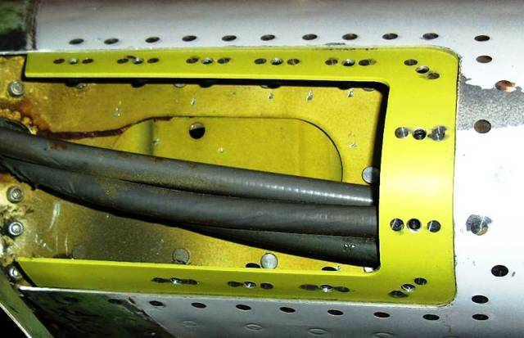

Slide 39
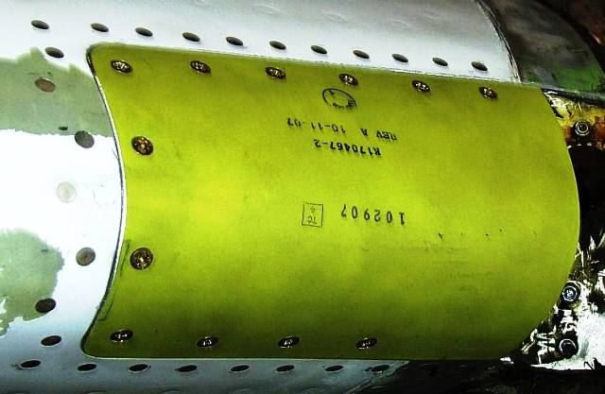
Return to summary
Contact info

Slide 40
Service Bulletin 235
Upper Rudder Structural Inspection

Slide 41
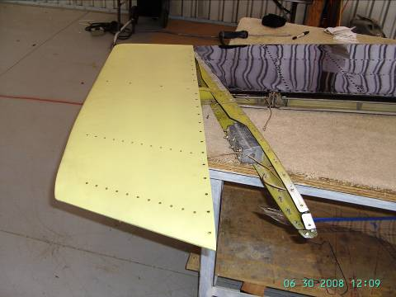
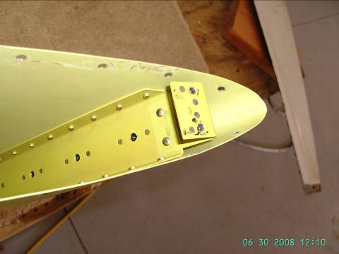
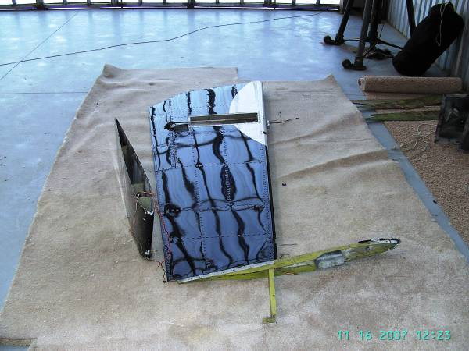
New aluminum rudder cap ready for install
Replaced Fiberglass Ruder Cap

Slide 42
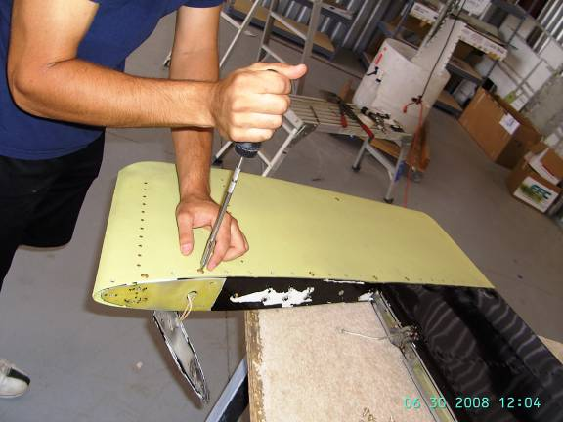
New aluminum rudder cap being installed

Slide 43
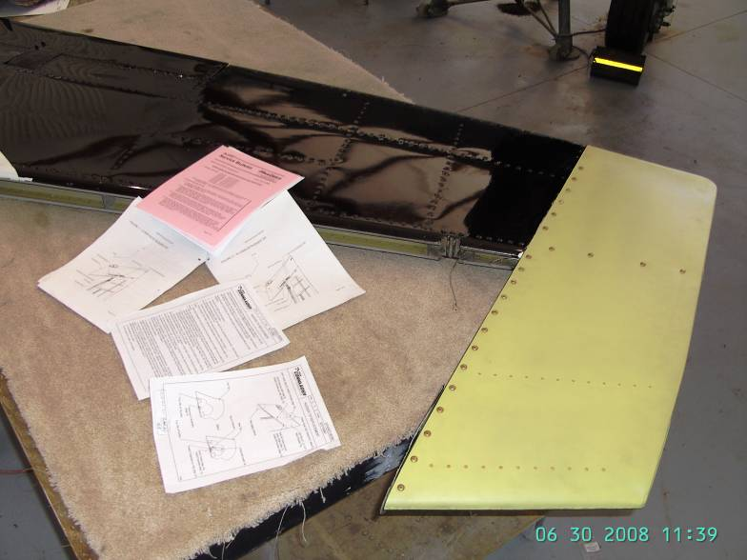
New Aluminum Rudder Installed and ready for paint
Return to summary
Contact Info

Slide 44
AD 06-15-01 (SB236A+238)
Aileron Spar Center Hinge and Inboard Hinge Inspection & Reinforcement

Slide 45
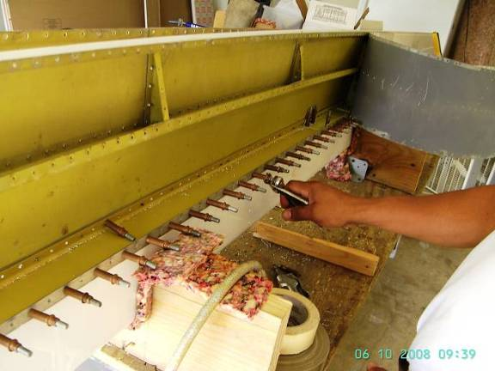
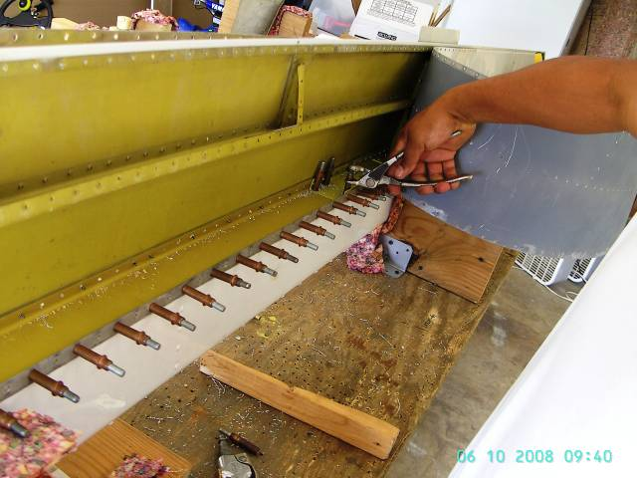
AD 06-15-01 (SB236A+238) being performed

Slide 46
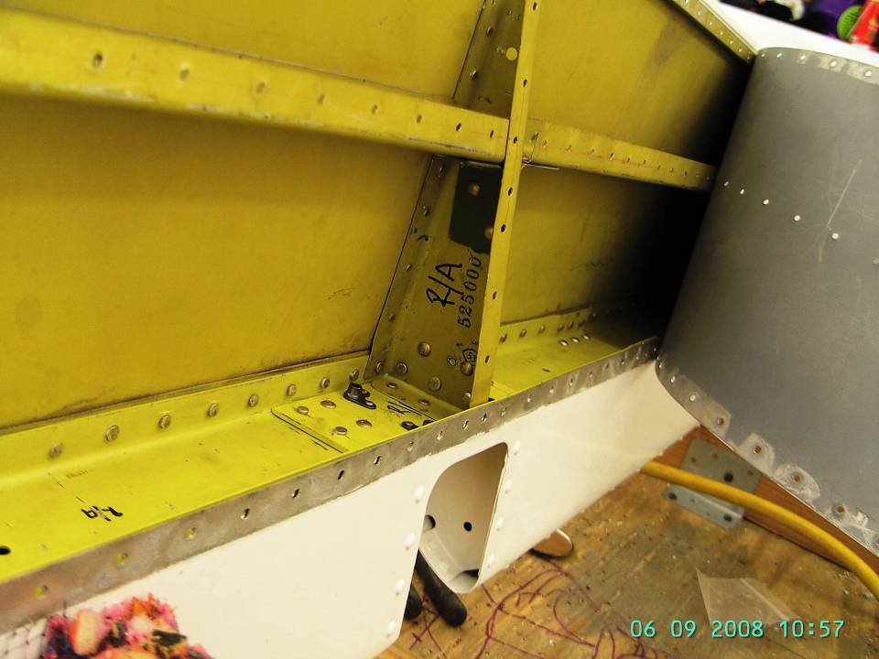
Right Aileron – View A
Center Hinge Reinforcement
New Spar

Slide 47
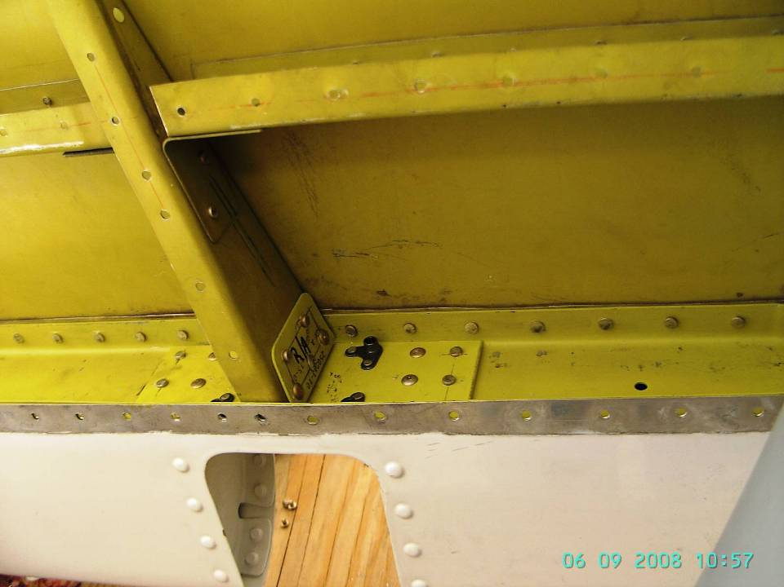
Right Aileron – (SB238) View B
Center Hinge Reinforcement
New Spar

Slide 48
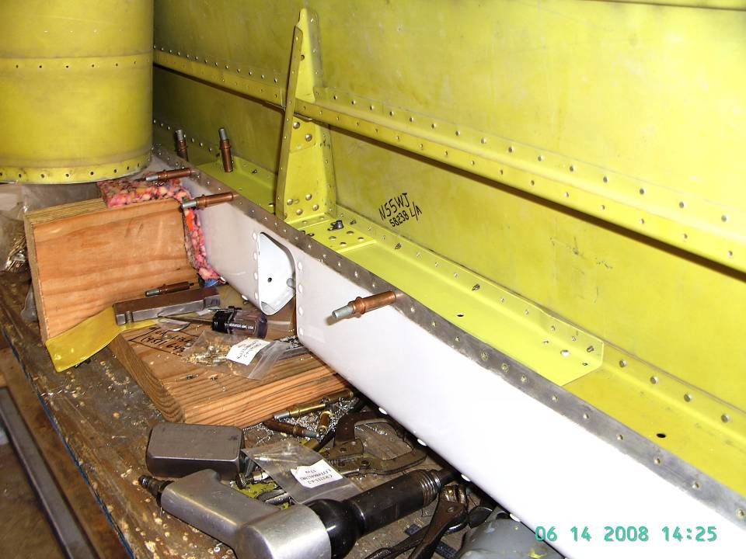
Left Aileron – View A
New Spar
Center Hinge Reinforcement

Slide 49
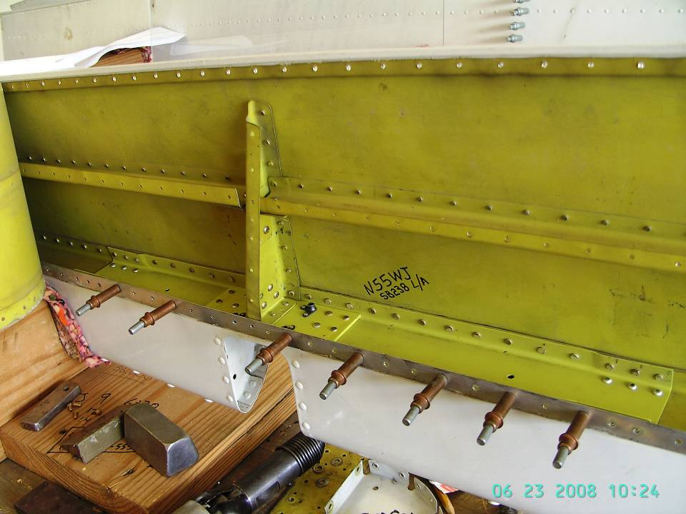
Left Aileron – View B
Center Hinge Reinforcement
Rivet line installed
New Spar

Slide 50
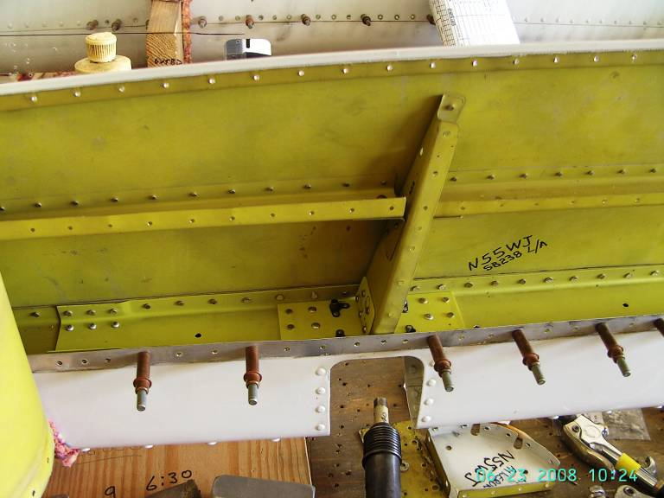
Left Aileron – View C
Center Hinge Reinforcement
Spar Splice

Slide 51
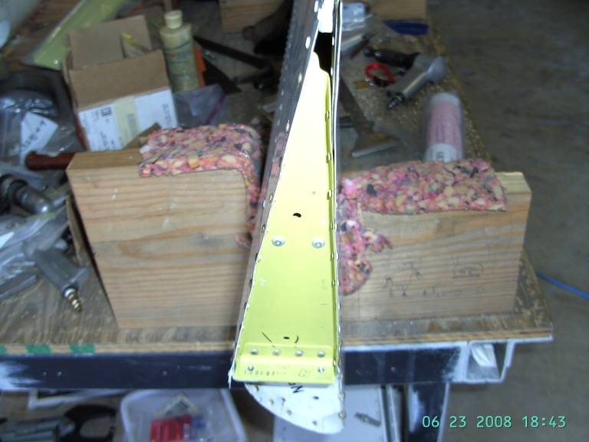
Right Aileron (SB236A)
Inboard Hinge Reinforcement
Reinforcement plate inside

Slide 52
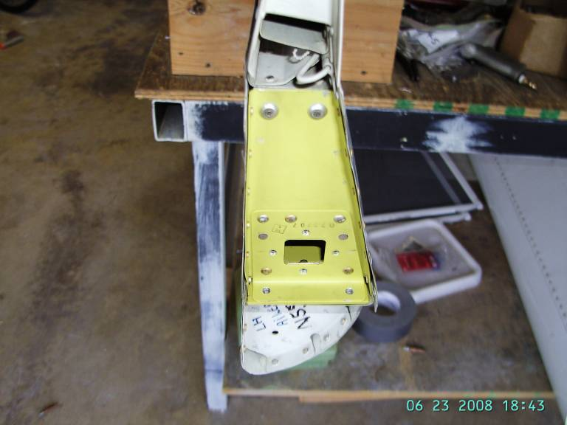
Left Aileron (SB236A)
Inboard Hinge Reinforcement
Reinforcement Plate

Slide 53
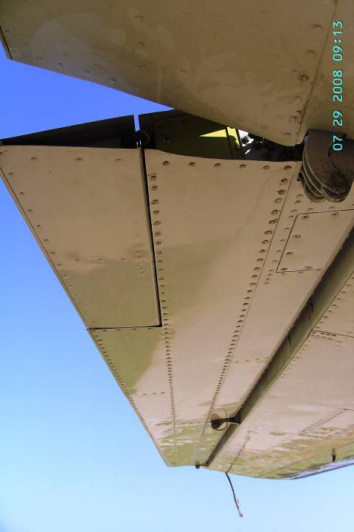

Left Aileron Installed
Right Aileron Installed
Return to summary
Contact info

Slide 54
SERVICE BULLETIN 237 (issuance of AD pending)
UPPER WING SKIN & STRAP – INSPECTION FOR CORROSION
Illustration of Part II: Modification & replacement of the upper wing skin / straps – Option C: Long modification

Slide 55

Upper skin removed

Slide 56


Corrosion found on upper skin

Slide 57

Corrosion found on upper wing skin

Slide 58

Corrosion found below removed upper wing straps

Slide 59


Straps not removed yet
Upper skin, frame and straps removed
Fuel bladders removed

Slide 60

Upper skin removed – View A

Slide 61

Upper skin removed – View B

Slide 62

New skin being manufactured

Slide 63

Upper skin and straps being installed

Slide 64

Upper left strap and plate installed
Sealant around skin, strap and plate applied

Slide 65

Right strap and plate installed

Slide 66

New stainless steel straps

Slide 67




Upper skin installed – Right Wing
Upper skin installed – Left Wing

Slide 68

Return to summary
Contact info

Slide 69
Service Bulletin 239 (Issuance of AD pending)
Outboard Flap – Inboard Hinge Inspection & Reinforcement

Slide 70


SB239

Slide 71


Return to Summary
Contact info

Slide 72
Service Bulletin 241 (AD 2013-09-05)
Inspection for cracking of the outer fuselage
Attachments, the lower wing main spar, the vertical channels, the upper picture window channels, aft cabin pressure web, external wing to fuselage fillets, and fasteners; repair or replacement of damage parts as necessary; and modification of the structure with reinforced parts.

Slide 73

Fitting removed to be replaced.

Slide 74

Installing pressure bulkhead doubler.

Slide 75

Upper channel on the picture window area.

Slide 76

Right side installation.

Slide 77
To find out more, contact the COBRA Team:
Ruben Correa
Cel.: (901) 438-5127
E-mail: eaglerdc@hotmail.com
Daniel Gardeazabal
Cel.: (901) 331-8809
E-mail: daniel@aerofix.net
Visit our website: www.aerofix.net
Return to summary

